Slide 1
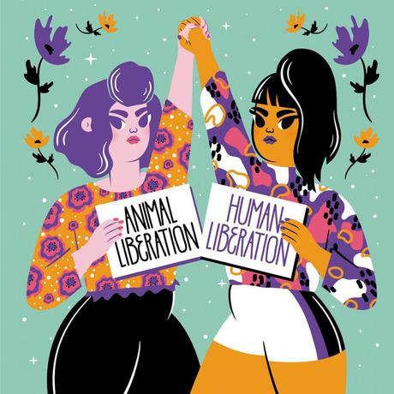
Food,Gender and Oppression in a Feminist Brazilian Perspective
Lívia Barbosa
Diego Santos
Veranise Dubeux
MEV3
2020

Slide 2
Food, Gender and Oppression in a Feminist Brazilian Perspective
I.Academic Context of the research
Contemporary Food Trends
The Ethical Food Turn
To eat right is not only a matter of nutrition
Social, environmental and ethical aspects of what we eat
To vote with your fork, reponsible eating, “eat right”
Changes in the meaning of “eating”
The personal is political
Daily life “saturated” with politics
Food as a source of social/political identities and moral hierarchies
The growth of vegetarianism/veganism all over the world
Animal Rights and Animal Welfare Activism
Fight against meat industry, environmental destruction,
Feminism and vegetarianism one dimension of this

Slide 3
Food, Gender and Oppression in a Feminist Brazilian Perspective
Feminism, food and oppression
Feminism and food
Troublesome historical relations with food, cooking and eating perceived through the lens of patriarchalism
Ecofeminists
Food is transformed into a key political weapon to fight against patriarchalism, capitalism and their structural oppression of women, animals and nature

Slide 4
Food, Gender and Oppression in a Feminist Brazilian Perspective
Theoretical Framework of Ecofeminism
All forms of oppression are interconnected, reinforce one another and are consequences of one single system of inequalities / patriarchalism
The oppression of animals is at the root of all other types of oppression
That is why sexism is so intimately linked to speciesism, racism, and other isms

Slide 5
Food, Gender and Oppression in a Feminist Brazilian Perspective
Theoretical Framework of Ecofeminism
Ethical vegetarianism should not be understood as a diet based on nutritional health and environmental reasons
Or a position adopted for the sake of animal rights, as argued by utilitarian and libertarian perspectives developed by Peter Singer, Tom Regan and many others
For ecofeminists the adoption of a vegetarian diet represents both an ethical attitude and a political act
It is a form of resistance to a capitalist male-dominant culture in which meat consumption is one of its sharpest expressions, that treats unequally and oppressively, both women and non-human animals. So,...

Slide 6
Food, Gender and Oppression in a Feminist Brazilian Perspective
To be a feminist implies also to be a vegetarian
Critics
Diane Curtis- Context moral vegetarianism ; modern contemporary society
Katherine Praxton George - Higher nutritional costs of a vegetarian diet for women, children and the elderly
Val Plumwood –Ontological Vegetarianism reinforces the division between man and nature . In its place Ecological Animalism
An attack in women´s autonomy and rights of choice that for centuries were curbed by patriarchal society

Slide 7
Brazilian Feminist Perceptions of Feminism and Vegetarianism
Feminism and Vegetarianism
Sample Charcateristics
History and trajectory of feminism
Food Habits and diets
Their perceptions about their own diets
Vegetarianism/Veganism
52% vegetarians or vegans
Knowledge about Ecofeminism
The link between feminism and vegetarianism
Sexism and Speciesism
Is Vegetarianism the correct moral behaviour for feminist women?

Slide 8
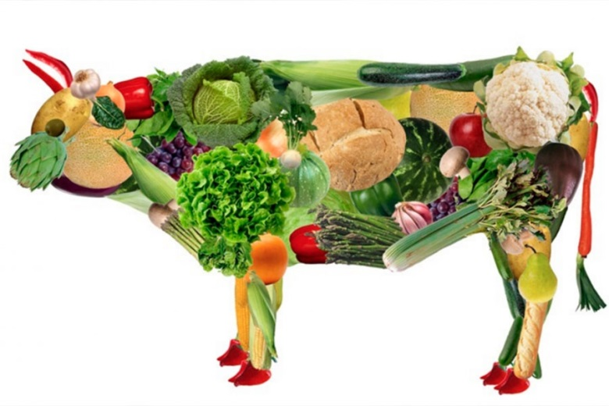
Results and Final Remarks
General Considerations
Knowledge of Ecofeminism

Slide 9
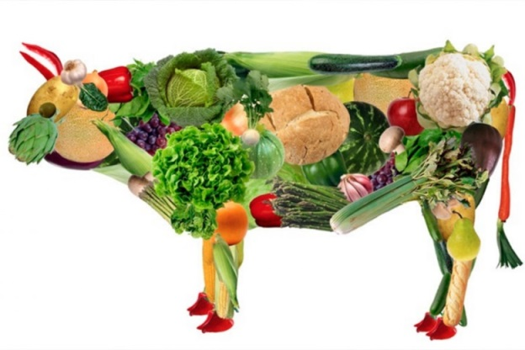
Food, Gender and Oppression in a Feminist Brazilian Perspective
I. Are the Oppression of Women and Animals structurally similar?
II. Is Vegetarianism the Correct Moral Behaviour for Feminist Women?

