Slide 1
Bath Packets
and gendered urban experience in Colombo
Nipesh Palat Narayanan
Postdoctoral Researcher
University of Colombo, Sri Lanka
https://bathpacket.wordpress.com

Slide 2
Contents
Position
1. Position
Methods
2. Methods
Gendered Urban Experience
3. Gendered Urban Experience
Making Bath Packets
Making Bath Packets
Selling Bath Packets
Selling Bath Packets
Conclusion
4. Conclusion

Slide 3
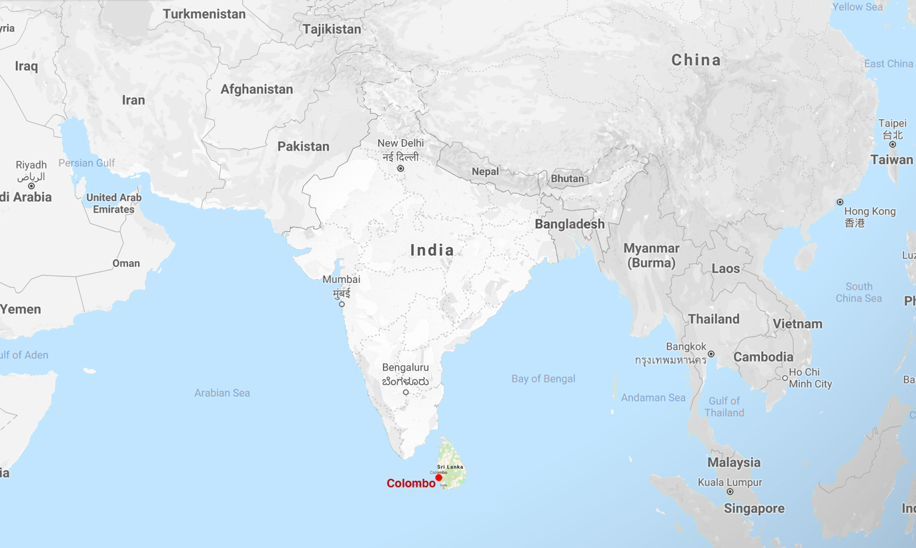
Case Location: Colombo, Sri Lanka
Position
Methods
Gendered Urban Experience
Making Bath Packets
Selling Bath Packets
Conclusion

Slide 4
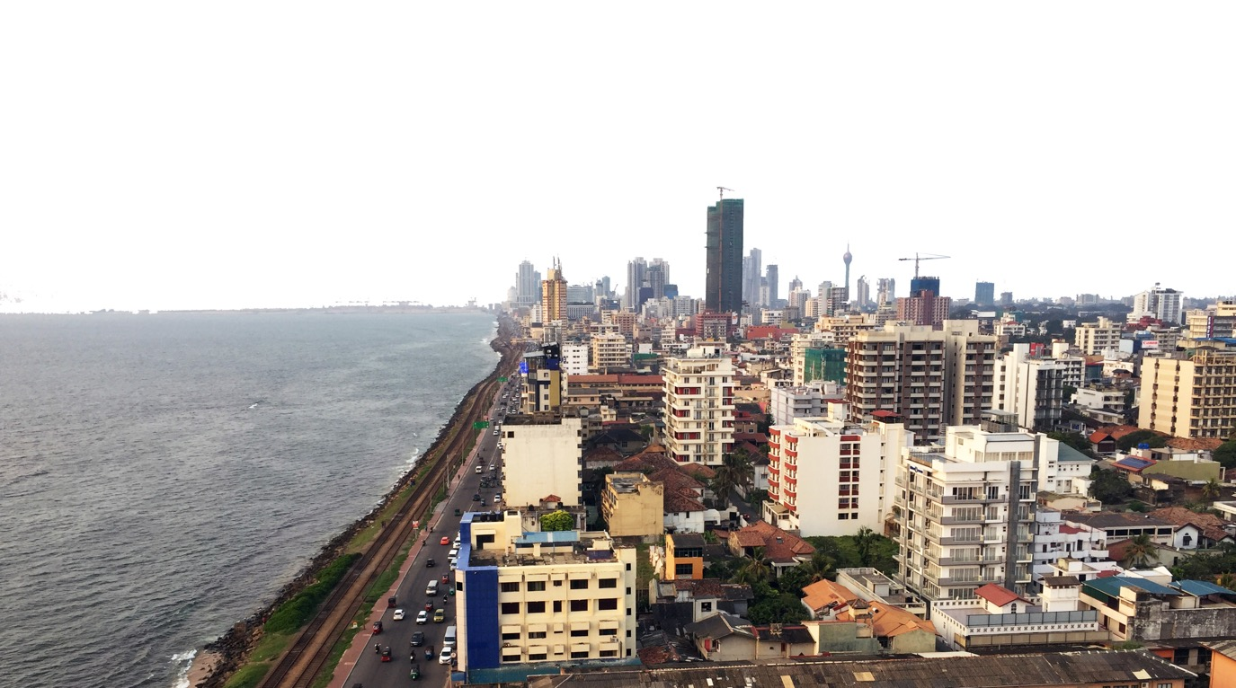
Case Location: Colombo, Sri Lanka
Position
Largest city in Sri Lanka
Population: 555,000
Floating Population: 500,000
Area: 37 Sq Km
Methods
Gendered Urban Experience
Making Bath Packets
Image Source: Author
Selling Bath Packets
Conclusion

Slide 5
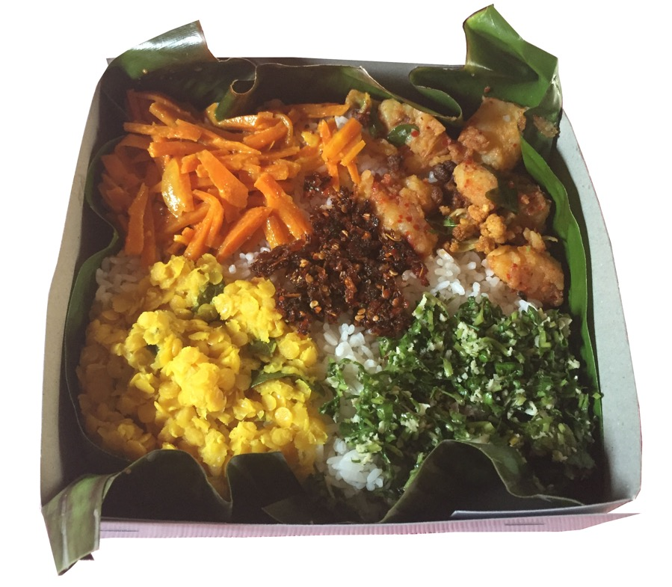
Bath Packet: Commodity
Position
Methods
Gendered Urban Experience
Making Bath Packets
Image Source: Author
Selling Bath Packets
Conclusion

Slide 6
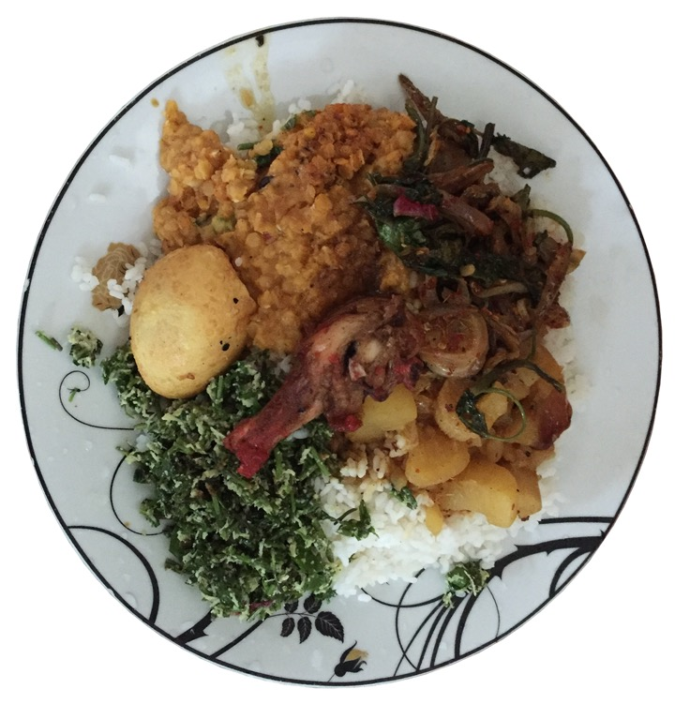
Rice & Curry: Eaten at Home
Position
Methods
Gendered Urban Experience
Making Bath Packets
Image Source: Author
Selling Bath Packets
Conclusion

Slide 7
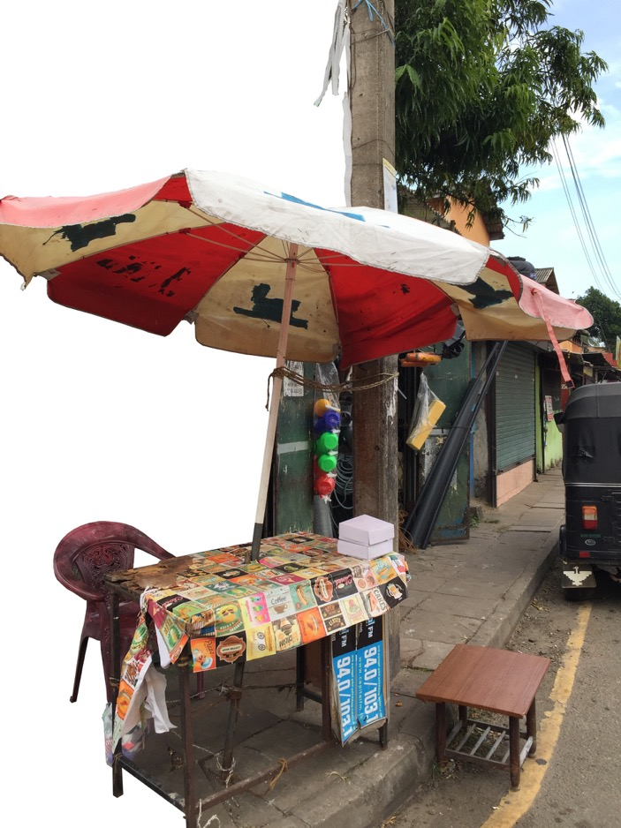
From Rice and Curry to Bath Packet
Position
Methods
Gendered Urban Experience
Image Source: Asanka
Making Bath Packets
Image Source: Author
Selling Bath Packets
Conclusion

Slide 8
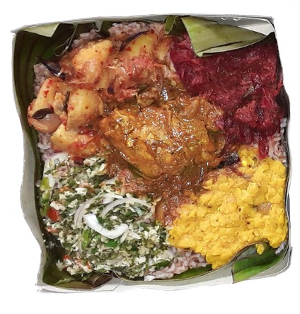
What is a Bath Packet?
Position
Packaged Rice and Curry
Commercial variant of what one brings from home
Not packed restaurant food
Methods
Gendered Urban Experience
Making Bath Packets
Image Source: Author
Selling Bath Packets
Conclusion

Slide 9
What is a Bath Packet?
Position
Packaged Rice and Curry
Commercial variant of what one brings from home
Not packed restaurant food
Wide cost variation
LKR 80 – 400 (5x difference)
Methods
Gendered Urban Experience
Making Bath Packets
Image Source: Author
Selling Bath Packets
Conclusion
1 KG rice = LKR 100 (approximately for white rice)

Slide 10
What is a Bath Packet?
Position
1. Principal condiment
Meat (beef, pork, chicken), Fish, Egg or vegetarian option
2. Dal (Parippu)
Split Red-Lentils
3. Vegetable 1
4. Vegetable 2
5. Raw condiment
Sambol
Rice
Methods
Gendered Urban Experience
Making Bath Packets
Image Source: Author
Selling Bath Packets
Conclusion

Slide 11
What is a Bath Packet?
Position
1. Principal condiment
Meat (beef, pork, chicken), Fish, Egg or vegetarian option
2. Dal (Parippu)
Split Red-Lentils
3. Vegetable 1
4. Vegetable 2
5. Raw condiment
Sambol
Rice
Methods
Gendered Urban Experience
Making Bath Packets
Image Source: Author
Selling Bath Packets
Conclusion

Slide 12
What is a Bath Packet?
Position
1. Principal condiment
Meat (beef, pork, chicken), Fish, Egg or vegetarian option
2. Dal (Parippu)
Split Red-Lentils
3. Vegetable 1
4. Vegetable 2
5. Raw condiment
Sambol
Rice
Methods
Gendered Urban Experience
Making Bath Packets
Image Source: Author
Selling Bath Packets
Conclusion

Slide 13
What is a Bath Packet?
Position
1. Principal condiment
Meat (beef, pork, chicken), Fish, Egg or vegetarian option
2. Dal (Parippu)
Split Red-Lentils
3. Vegetable 1
4. Vegetable 2
5. Raw condiment
Sambol
Rice
Methods
Gendered Urban Experience
Making Bath Packets
Image Source: Author
Selling Bath Packets
Conclusion

Slide 14
What is a Bath Packet?
Position
1. Principal condiment
Meat (beef, pork, chicken), Fish, Egg or vegetarian option
2. Dal (Parippu)
Split Red-Lentils
3. Vegetable 1
4. Vegetable 2
5. Raw condiment
Sambol
Rice
Methods
Gendered Urban Experience
Making Bath Packets
Image Source: Author
Selling Bath Packets
Conclusion

Slide 15
What is a Bath Packet?
Position
“Eaten and produced by a wide range of people…”
Methods
Gendered Urban Experience
Making Bath Packets
Image Source: Author
Selling Bath Packets
Conclusion

Slide 16
Intent behind investigating a Bath Packet
Position
Methods
Gendered Urban Experience
Making Bath Packets
Selling Bath Packets
Conclusion

Slide 17
Intent behind investigating a Bath Packet
Position
Eurocentric Urban Understanding (& Urban Theory)
Our urban understanding is biased – Eurocentric (North Atlantic)
Methods
Gendered Urban Experience
Making Bath Packets
Selling Bath Packets
Conclusion
Connell, R. 2011. Southern theory: the global dynamics of knowledge in social science Reprinted. Cambridge: Polity Press.

Slide 18
Intent behind investigating a Bath Packet
Position
Eurocentric Urban Understanding (& Urban Theory)
Our urban understanding is biased – Eurocentric (North Atlantic)
Methods
Provincialize: Understand Cities in Their Own Right
Not in comparison to Eurocentric urban theory emanating from cities like London, Paris, & New York
Gendered Urban Experience
Making Bath Packets
Selling Bath Packets
Conclusion
Palat Narayanan, N. 2020. Southern Theory without a North: City Conceptualization as the Theoretical Metropolis. Annals of the American Association of Geographers :1–13.

Slide 19
Intent behind investigating a Bath Packet
Position
Eurocentric Urban Understanding (& Urban Theory)
Our urban understanding is biased – Eurocentric (North Atlantic)
Methods
Provincialize: Understand Cities in Their Own Right
Not in comparison to Eurocentric urban theory emanating from cities like London, Paris, & New York
Gendered Urban Experience
Making Bath Packets
Urban Understanding
Food
Selling Bath Packets
via
Conclusion
Palat Narayanan, N., and R. Véron. 2018. Informal production of the city: Momos, migrants, and an urban village in Delhi. Environment and Planning D: Society and Space 36 (6):1026–1044.

Slide 20
Understanding Colombo in its own right
Position
Understanding Colombo
Bath Packets
via
Methods
Gendered Urban Experience
Making Bath Packets
Selling Bath Packets
Conclusion

Slide 21
Understanding Colombo in its own right
Position
Understanding Colombo
Bath Packets
via
Methods
Bath Packets
Imitates the cultural practices of parcelled rice & curry
Gendered Urban Experience
Making Bath Packets
Selling Bath Packets
Conclusion

Slide 22
Understanding Colombo in its own right
Position
Understanding Colombo
Bath Packets
via
Methods
Bath Packets
Imitates the cultural practices of parcelled rice & curry
Gendered Urban Experience
Making Bath Packets
Cultural Practices
&
Spatial Urban Experiences
Selling Bath Packets
Conclusion

Slide 23
Understanding Colombo in its own right
Position
Understanding Colombo
Bath Packets
via
Methods
Bath Packets
Imitates the cultural practices of parcelled rice & curry
Gendered Urban Experience
Making Bath Packets
Cultural Practices
&
Spatial Urban Experiences
Selling Bath Packets
Conclusion

Slide 24
Methods
Position
Urban
Food
Methods
Two Cases
Dinithi
Wishaka
(Selling bath packets in a central Colombo district)
Gendered Urban Experience
Making Bath Packets
Selling Bath Packets
Conclusion

Slide 25
Methods
Position
Urban
Food
Methods
Two Cases
Dinithi
Wishaka
(Selling bath packets in a central Colombo district)
Gendered Urban Experience
Semi-structured Interviews
Producers and Sellers (20 nos.)
Qualitative Surveys
Producers, Sellers, and Buyers (50 nos.)
Participant Observation
Making Bath Packets
Selling Bath Packets
Conclusion

Slide 26
Gendered Urban Experience
Position
Dinithi
Wishaka
Methods
Selling bath packets, less than 100 m from each other in a central Colombo district
Gendered Urban Experience
Making Bath Packets
Selling Bath Packets
Conclusion

Slide 27
Gendered Urban Experience
Position
Dinithi
Wishaka
Methods
Gendered Urban Experience
Making Bath Packets
Selling Bath Packets
Conclusion

Slide 28
Gendered Urban Experience
Position
Dinithi
2016: Takeover of family-owned shop
Opens ‘healthy’ juice shop
Wishaka
Methods
Gendered Urban Experience
Making Bath Packets
Selling Bath Packets
Conclusion

Slide 29
Gendered Urban Experience
Position
Dinithi
2016: Takeover of family-owned shop
Opens ‘healthy’ juice shop
2017: Started selling bath packets
Lives in big house behind the shop
Maids + cook
Wishaka
Methods
Gendered Urban Experience
Making Bath Packets
Selling Bath Packets
Conclusion

Slide 30
Gendered Urban Experience
Position
Dinithi
2016: Takeover of family-owned shop
Opens ‘healthy’ juice shop
2017: Started selling bath packets
Lives in big house behind the shop
Maids + cook
Sale: 40 bath packets per day
Cost: LKR 325-375
Location: Shop
Wishaka
Methods
Gendered Urban Experience
Making Bath Packets
Selling Bath Packets
Conclusion
1 KG rice = LKR 100 (approximately for white rice)

Slide 31
Gendered Urban Experience
Position
Dinithi
2016: Takeover of family-owned shop
Opens ‘healthy’ juice shop
2017: Started selling bath packets
Lives in big house behind the shop
Maids + cook
Sale: 40 bath packets per day
Cost: LKR 325-375
Location: Shop
Wishaka
2018: Lost job (jewellery shop)
Mother suggested bath packets
Methods
Gendered Urban Experience
Making Bath Packets
Selling Bath Packets
Conclusion
1 KG rice = LKR 100 (approximately for white rice)

Slide 32
Gendered Urban Experience
Position
Dinithi
2016: Takeover of family-owned shop
Opens ‘healthy’ juice shop
2017: Started selling bath packets
Lives in big house behind the shop
Maids + cook
Sale: 40 bath packets per day
Cost: LKR 325-375
Location: Shop
Wishaka
2018: Lost job (jewellery shop)
Mother suggested bath packets
2019: Started selling bath packet
Lives outside Colombo
Makes at home and travels to sell
Methods
Gendered Urban Experience
Making Bath Packets
Selling Bath Packets
Conclusion
1 KG rice = LKR 100 (approximately for white rice)

Slide 33
Gendered Urban Experience
Position
Dinithi
2016: Takeover of family-owned shop
Opens ‘healthy’ juice shop
2017: Started selling bath packets
Lives in big house behind the shop
Maids + cook
Sale: 40 bath packets per day
Cost: LKR 325-375
Location: Shop
Wishaka
2018: Lost job (jewellery shop)
Mother suggested bath packets
2019: Started selling bath packet
Lives outside Colombo
Makes at home and travels to sell
Sale: 30 bath packets per day
Cost: LKR 120-200
Location: Footpath
Methods
Gendered Urban Experience
Making Bath Packets
Selling Bath Packets
Conclusion
1 KG rice = LKR 100 (approximately for white rice)

Slide 34
Gendered Urban Experience: Class-based gender performativity
Position
Dinithi
Healthy food – Starting logic
“As a Buddhist we cannot give anything bad to people, especially food. You can donate your old clothes to someone, it just covers the body no. But food is not like that, it needs to be very clean, hygienic, and healthy. Also when you see the food you should feel like eating [referring to the poor quality of bath packets elsewhere]. We put a banana leaf in our packets, I personally make sure that it is washed and wiped.”
Wishaka
Methods
Gendered Urban Experience
Making Bath Packets
Selling Bath Packets
Conclusion

Slide 35
Gendered Urban Experience: Class-based gender performativity
Position
Dinithi
Healthy food – Starting logic
“As a Buddhist we cannot give anything bad to people, especially food. You can donate your old clothes to someone, it just covers the body no. But food is not like that, it needs to be very clean, hygienic, and healthy. Also when you see the food you should feel like eating [referring to the poor quality of bath packets elsewhere]. We put a banana leaf in our packets, I personally make sure that it is washed and wiped.”
Wishaka
Methods
Gendered Urban Experience
Making Bath Packets
Selling Bath Packets
Conclusion

Slide 36
Gendered Urban Experience: Class-based gender performativity
Position
Dinithi
Healthy food – Starting logic
“As a Buddhist we cannot give anything bad to people, especially food. You can donate your old clothes to someone, it just covers the body no. But food is not like that, it needs to be very clean, hygienic, and healthy. Also when you see the food you should feel like eating [referring to the poor quality of bath packets elsewhere]. We put a banana leaf in our packets, I personally make sure that it is washed and wiped.”
Wishaka
Extension of work at home
Feeding the family
Scaling up existing work
Cooking
Help from Mother & Sister
Quality embedded
Methods
Gendered Urban Experience
Making Bath Packets
Selling Bath Packets
Conclusion

Slide 37
Gendered Urban Experience: Class-based gender performativity
Position
Dinithi
Discourse of care
Overseeing every detail.
The output
Wishaka
Discourse of care
Cooking herself
The process
Methods
Gendered Urban Experience
Making Bath Packets
Selling Bath Packets
Conclusion

Slide 38
Gendered Urban Experience: Class-based gender performativity
Position
Dinithi
Discourse of care
Overseeing every detail.
The output
Wishaka
Discourse of care
Cooking herself
The process
Methods
Gendered Urban Experience
Making Bath Packets
Imitating: Packed rice and curry used to be cooked by mother (wife). Care/love.
Commercial Replacement
Men and women sellers
Selling Bath Packets
Conclusion

Slide 39
Gendered Urban Experience: Differing conception of the city
Position
Dinithi
Raw Materials
Supermarket
Never from ‘Pettah’
(wholesale market)
Wishaka
Methods
Gendered Urban Experience
Making Bath Packets
Selling Bath Packets
Conclusion

Slide 40
Gendered Urban Experience: Differing conception of the city
Position
Dinithi
Raw Materials
Supermarket
Never from ‘Pettah’
(wholesale market)
Wishaka
Raw Material
Pettah
Muslim meat shop
“There is a large variety in Pettah and once you know the shopkeeper you get a good deal. The produce is fresh due to large turnover of the market. However, I buy fish from the local shop to easily carry it home without it going bad and meat from a nearby Muslim shop.”
Methods
Gendered Urban Experience
Making Bath Packets
Selling Bath Packets
Conclusion

Slide 41
Gendered Urban Experience: Differing conception of the city
Position
Dinithi
Raw Materials
Supermarket
Never from ‘Pettah’
(wholesale market)
Wishaka
Raw Material
Pettah
Muslim meat shop
“There is a large variety in Pettah and once you know the shopkeeper you get a good deal. The produce is fresh due to large turnover of the market. However, I buy fish from the local shop to easily carry it home without it going bad and meat from a nearby Muslim shop.”
Methods
Gendered Urban Experience
Making Bath Packets
Selling Bath Packets
Conclusion

Slide 42
Gendered Urban Experience: Differing conception of the city
Position
Dinithi
City
Supermarket
Frozen meat
Wishaka
City
Wholesale market
‘Muslim’ meat shop
Methods
Gendered Urban Experience
Making Bath Packets
Selling Bath Packets
Conclusion

Slide 43
Gendered Urban Experience: Differing conception of the city
Position
Dinithi
City
Supermarket
Frozen meat
Wishaka
City
Wholesale market
‘Muslim’ meat shop
Methods
Gendered Urban Experience
Physically the same city, but socially different.
Understanding
Experiences
Memories
Making Bath Packets
Selling Bath Packets
Conclusion

Slide 44
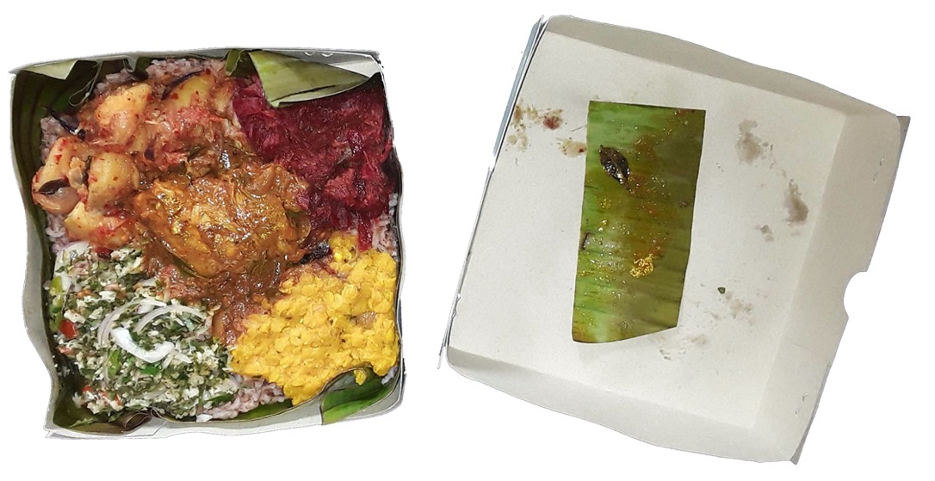
Gendered Urban Experience: Food Preferences
Position
Dinithi
Packaging
Paper Box
Wishaka
Methods
Gendered Urban Experience
Making Bath Packets
Image Source: Author
Selling Bath Packets
Conclusion

Slide 45
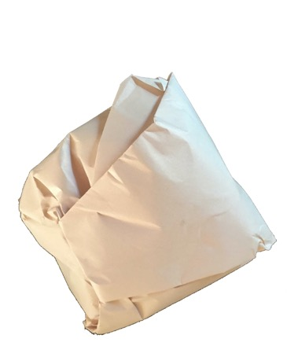
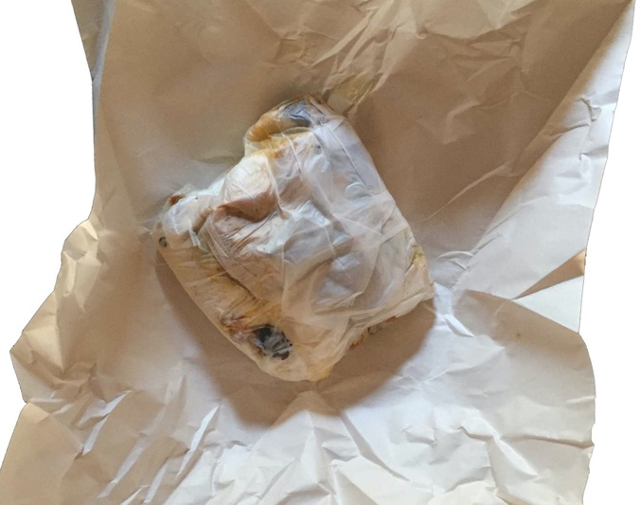
Gendered Urban Experience: Food Preferences
Position
Dinithi
Packaging
Paper Box
Wishaka
Packaging
Paper wrap
Methods
Gendered Urban Experience
Making Bath Packets
Image Source: Author
Selling Bath Packets
Conclusion

Slide 46
Gendered Urban Experience: Food Preferences
Position
Dinithi
Packaging
Paper Box
Sale
Internet + Phone
Brand
Wishaka
Packaging
Paper wrap
Sale
Location specificity
Methods
Gendered Urban Experience
Making Bath Packets
Selling Bath Packets
Conclusion

Slide 47
Gendered Urban Experience: Food Preferences
Position
Dinithi
Packaging
Paper Box
Sale
Internet + Phone
Brand
Wishaka
Packaging
Paper wrap
Sale
Location specificity
Methods
Gendered Urban Experience
Making Bath Packets
“If you buy from me at the footpath, it is cheaper. I sell the same packet for more on XXX (a popular app-based food delivery system). If I sell in XXX at the same price, then no one will buy. They buy once, like the taste and buy again, but for them to know the taste they have to buy once.”
Selling Bath Packets
Conclusion

Slide 48
Conclusion
Position
Class Based gender Performativity
Home-cooked
Care discourse and food
Methods
Gendered Urban Experience
Making Bath Packets
Selling Bath Packets
Conclusion
Mohanty, C. T. 2003. “Under Western Eyes” Revisited: Feminist Solidarity through Anticapitalist Struggles. Signs: Journal of Women in Culture and Society 28 (2):499–535.

Slide 49
Conclusion
Position
Class Based gender Performativity
Home-cooked
Care discourse and food
Differing conception of the city
Secular vs religious connotations of food
Place based quality judgement
Methods
Gendered Urban Experience
Making Bath Packets
Selling Bath Packets
Conclusion
Low, K. E. Y., and E. Lynn-Ee Ho. 2018. Eating in the city. Food, Culture & Society 21 (1):2–8.

Slide 50
Conclusion
Position
Class Based gender Performativity
Home-cooked
Care discourse and food
Differing conception of the city
Secular vs religious connotations of food
Place based quality judgement
Class connotation of food
Cost + Packaging
Differing perceptions of – ‘Healthy’, ‘Home cooked’
Methods
Gendered Urban Experience
Making Bath Packets
Selling Bath Packets
Conclusion
Parsons, J. M. 2016. When convenience is inconvenient: ‘healthy’ family foodways and the persistent intersectionalities of gender and class. Journal of Gender Studies 25 (4):382–397.

Slide 51
Conclusion
Position
Class Based gender Performativity
Home-cooked
Care discourse and food
Differing conception of the city
Secular vs religious connotations of food
Place based quality judgement
Class connotation of food
Cost + Packaging
Differing perceptions of – ‘Healthy’, ‘Home cooked’
Methods
Gendered Urban Experience
Making Bath Packets
Selling Bath Packets
Both food and urban are socio-cultural constructs,
more studies are required to investigate
how they co-constitute each other.
Conclusion

Slide 52
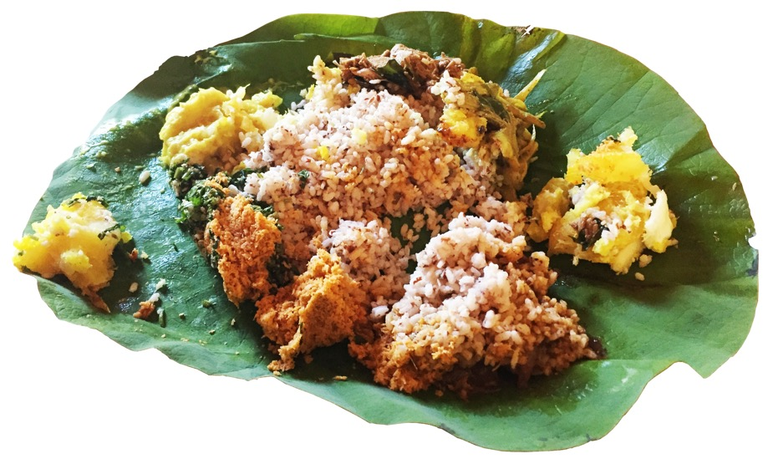
Bath Packets
and gendered urban experience in Colombo
Image Source: Author
Project log:
https://bathpacket.wordpress.com

